Slide 1

Design and Prototyping of an application using a human-centered approach
Final Presentation and Demo - Assignment nº 2
Daniel Figueiredo 98498
Eduardo Fernandes 98512
João Borges 98155

Slide 2
Introduction
Virtual Guide
Motivation:
Having the ability to discover a new city
Why this project ?
Low number of apps that covers this theme
Personal Interest:
Get to know the routes from unknown places

Slide 3
Project Objectives
Virtual Guide
High-level goals:
Show tourist routes filtered by, location, route type or by tourist guide
Have a main page with recomended routes
Allows to visit and learn a little bit more about the place
Benefits:
Flexible
Increases the user's cultural knowledge
Fast way, for a tourist, to choose a route in a place

Slide 4

Personas
Virtual Guide
Name: George Flynn
Gender: Male
Age: 36
Profession: Doctor
Main motives: Weariness, Curiosity about touristic points and different cultures.
Objectives: Psychologically rest, visit places with lots of touristic points, have the maximum avail of the visit with the minimum amount of time.

Slide 5
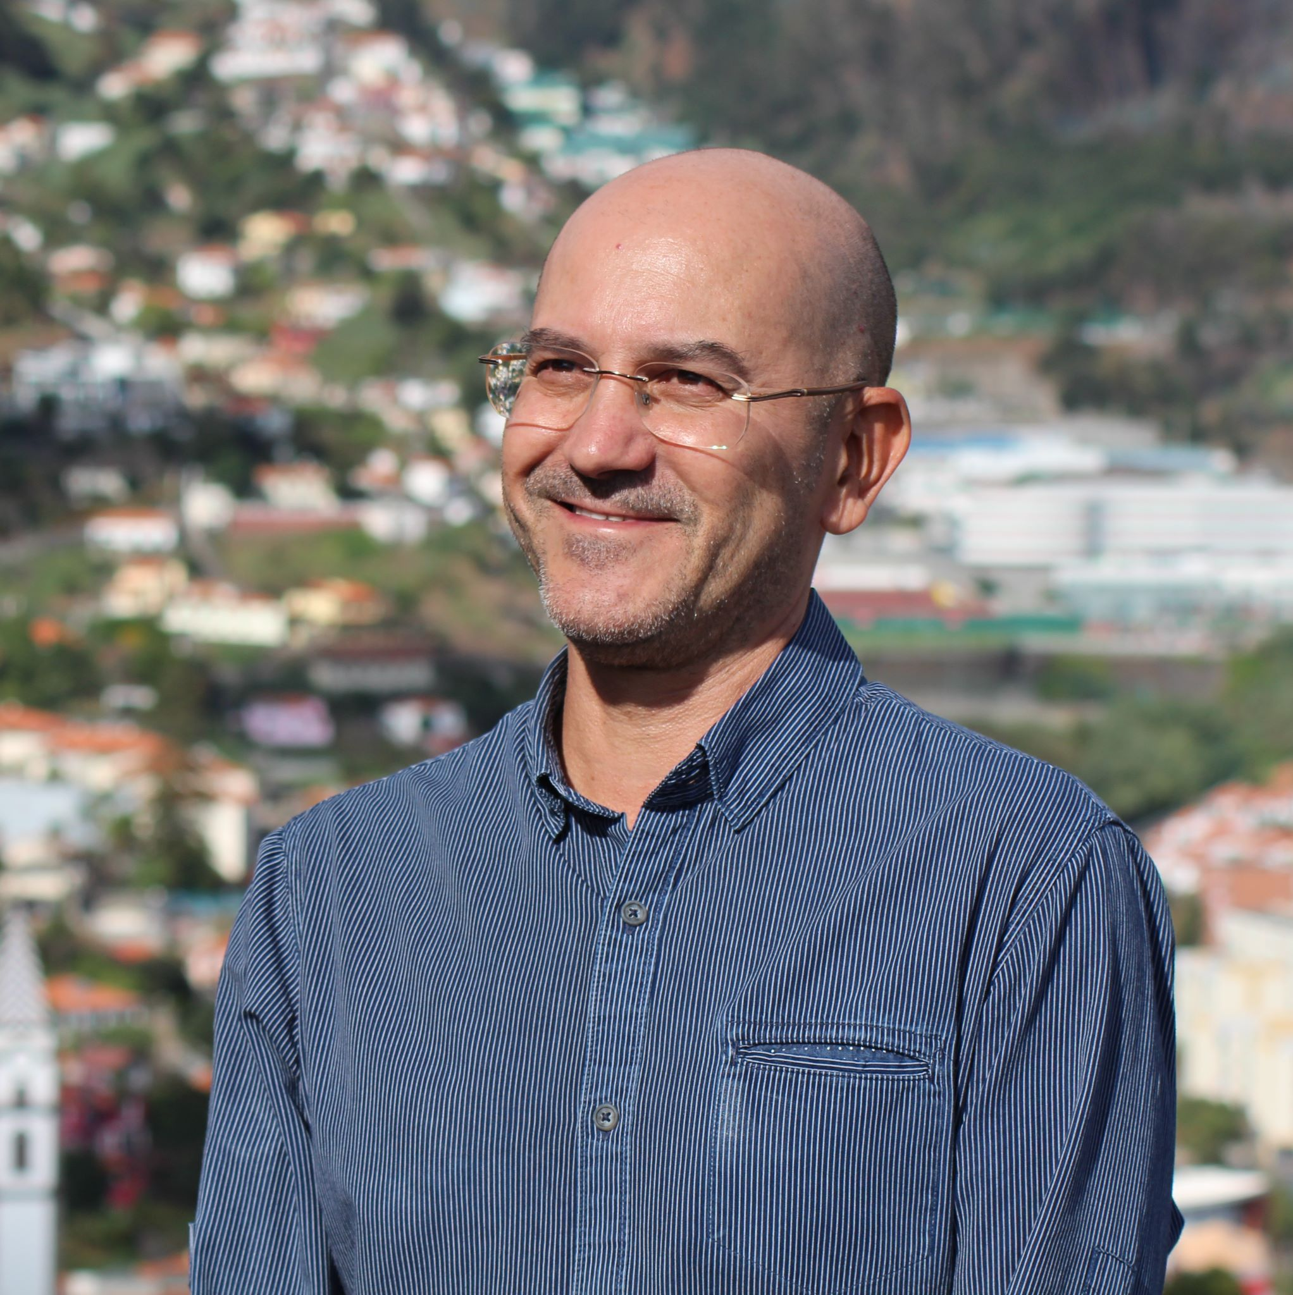
Personas
Virtual Guide
Name: Fernando Rias
Gender: Male
Age: 45
Profession: Librarian
Main motives: Will to help new visitors.
Objectives: Interchange knowledge, improve touristic experience.

Slide 6
Scenarios
Virtual Guide
George is tired of his job and decided to go on vacations to Algarve.
He doesn't know to much about this place, so he starts using the app.
Finally, he find a place called “Praia da Rocha” and decides to visit it.
Fernando checks the routes that he created to see if it was possible to do any improvement
He notices that there is a monument, the “Cristo Rei”, that is far away from the route that he designate
Finally, he proceeds to change his route so that it eases the life of the user to be able to see the monument better

Slide 7
Tasks
Virtual Guide
Doctor
0. Get a route
Plan 0: 4-5-6
If gps location services aren’t active: 1-2-4-5-6
If the visit is to a different place from where the user is: 3-4-5-6
1. Go to GPS definitions
2. Turn GPS on
3. Choose a different location
4. Get Categories
5. Choose a tourist guide
6. Visit the places in the route

Slide 8
Tasks
Virtual Guide
Tourist Guide
0. Create a route
Plan 0: 1-2-3
If tourist guide wants to do changes to his own route: 4-5-6
1. Select the category
2. Select the places
3. Post the new route
4. Edit the route
5. Switch places
6. Save the new route

Slide 9
Requirements
Virtual Guide
Non-functional requirements
Functional requirements
Data security
Intuitive and easy learning
Appealing interface
Performance and scalability
Easy access
Search for routes in actual location or in a different location
Create and edit routes
Recommendation menu (high rated routes)
Check detailed information about every route

Slide 10

Low Fidelity Prototype
Virtual Guide
Prototype made in paper
The app as the following main funcionalities:
Search for routes on atual location or different location;
Create and edit route.

Slide 11
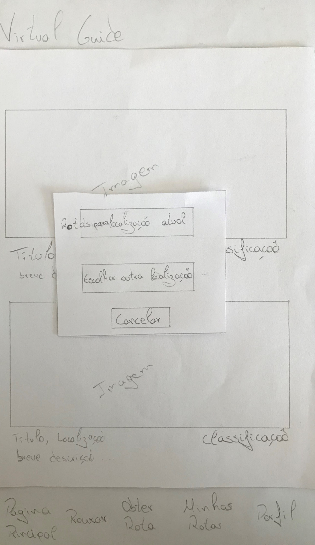
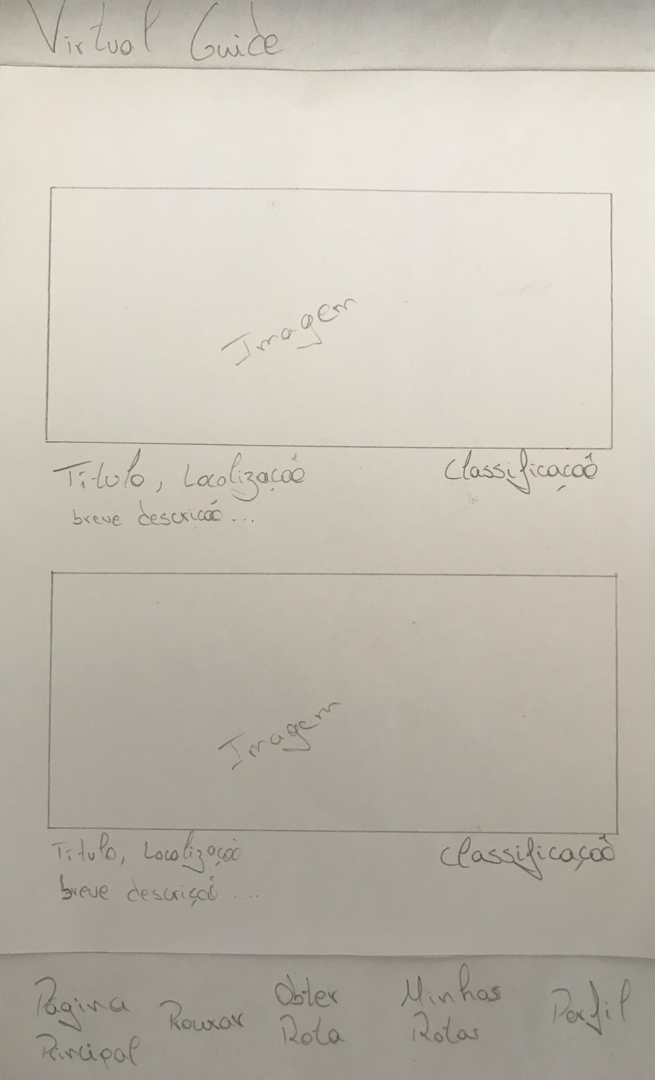
Low Fidelity Prototype
Virtual Guide

Slide 12
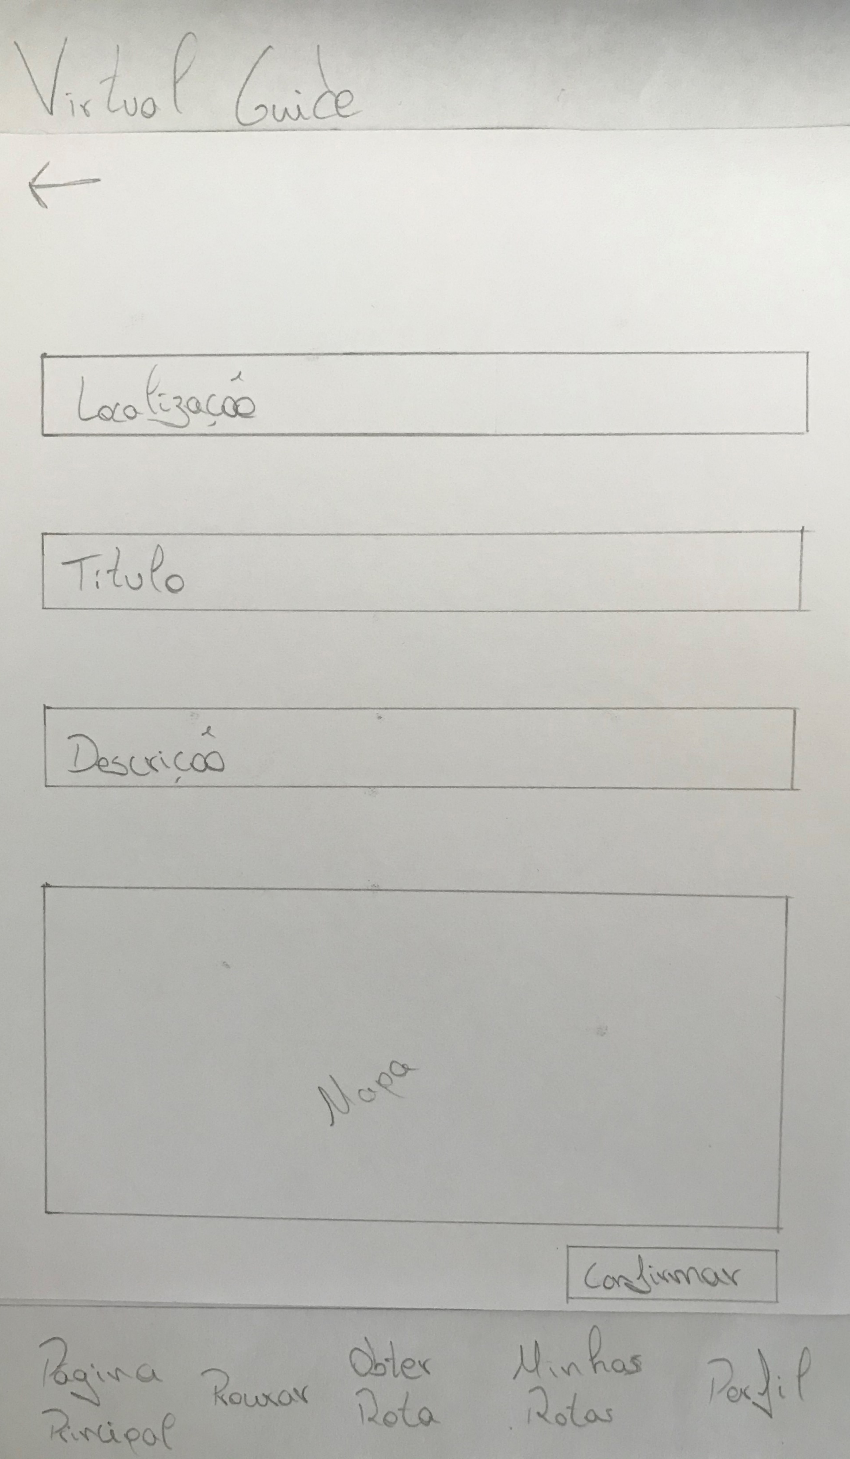
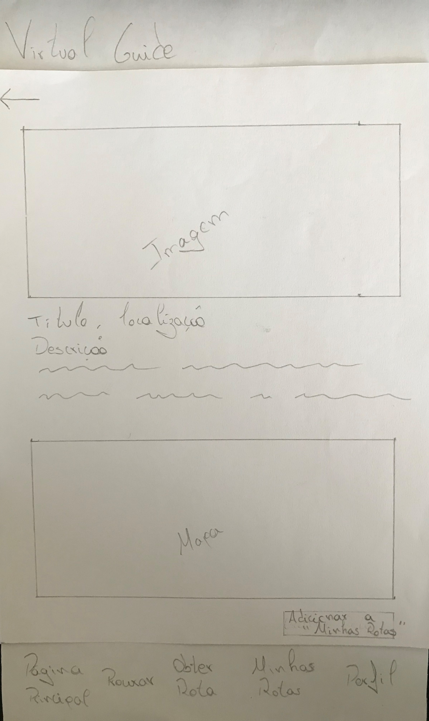
Low Fidelity Prototype
Virtual Guide

Slide 13
User Evaluation
Virtual Guide
Google Forms to store the information collected from the user.
The objective was to evaluate the app as well as its characteristics.
Tasks:
[Turist]Choose a route at a different location from its own;
[Turist]Choose a route at his own location;
[Guider]Create a route;
[Guider]Edit a route.
Total of 7 participants.

Slide 14
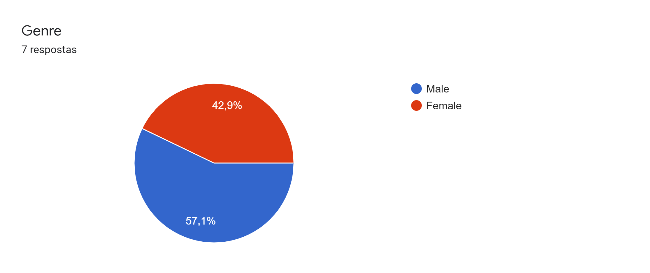
User Evaluation
Virtual Guide

Slide 15
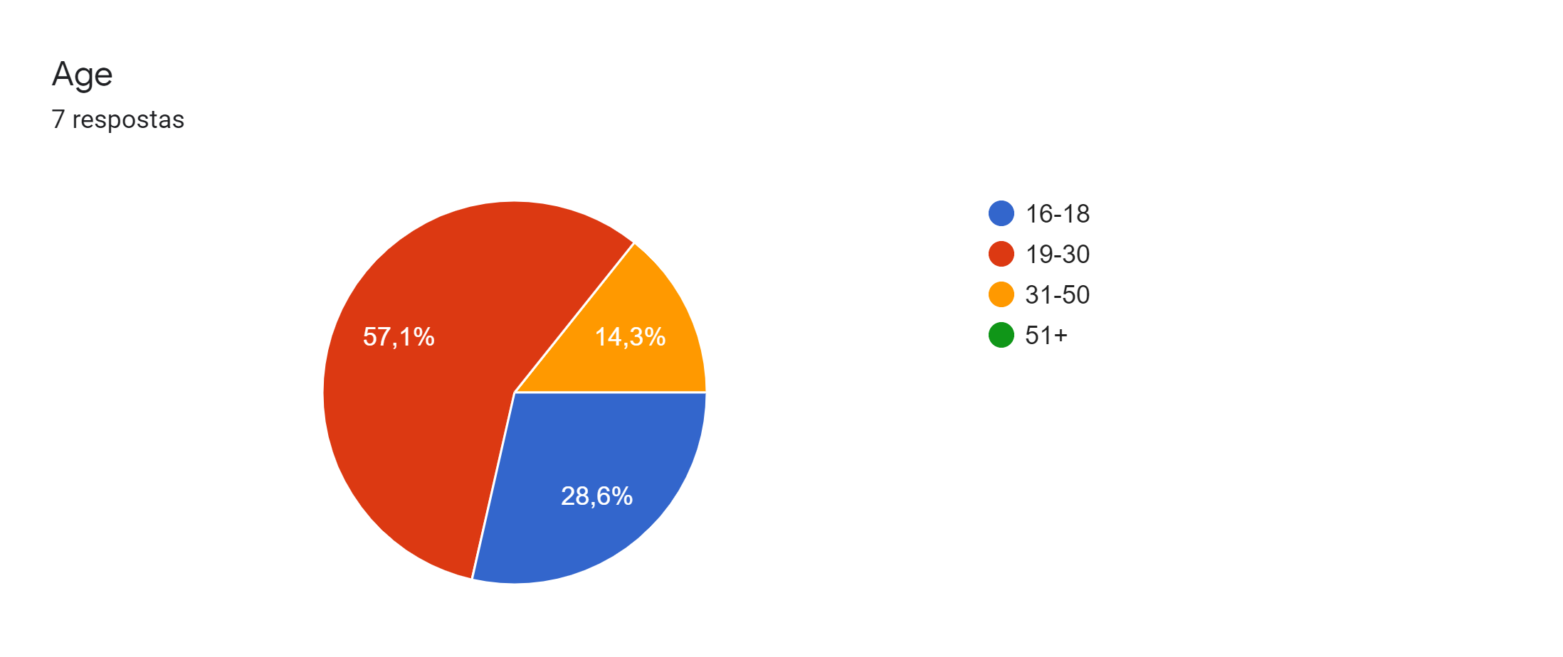
User Evaluation
Virtual Guide

Slide 16
LFP - User Evaluation Results
Virtual Guider
1 - Very hard 2 - Hard 3 - Normal 4 - Easy 5 - Very Easy

Slide 17
LFP - User Evaluation Results
Virtual Guider
1 - Very hard 2 - Hard 3 - Normal 4 - Easy 5 - Very Easy

Slide 18

LFP - User Evaluation Results
Virtual Guider
Main changes after user evaluation:
On the side of the turist:
  Alter home page, referencing exactly what was being presented to the user (Recommendation Menu);
On the side of the guider:
  Alter “My routes” to be more clear, where was the edit option on the created routes.

Slide 19

High fidelity prototype
Virtual Guide
Tested the same tasks with the same participants.
The objective was to see, if when the application was created and ready to use, the testers will notice different difficulties.

Slide 20


Platform Used for the functional prototype
Virtual Guide
Android Studio
Github

Slide 21
Heuristic Evaluation on Functional Prototype
Virtual Guide
Problem – Heuristic | Pedro | André | Eva
Can’t see what the user is typing on the create route tab - Visibility of system status | 1 | 2 | 2
Pop-up don’t have close icon - User control and freedom | - | - | 1
Edit button opens a edit tab but the fields are empty - Consistency and standards | 3 | 2 | -

Slide 22
DEMO

Slide 23
Future work
Virtual Guide
If you were to continue the project, what would be the next steps?
Implementation of filters in the routes;
When a route is selected, see if there are more routes from different guiders;
See all routes from a specific guider;
Database, for routes and guiders;
Implement multiple languages.

